Slide 1
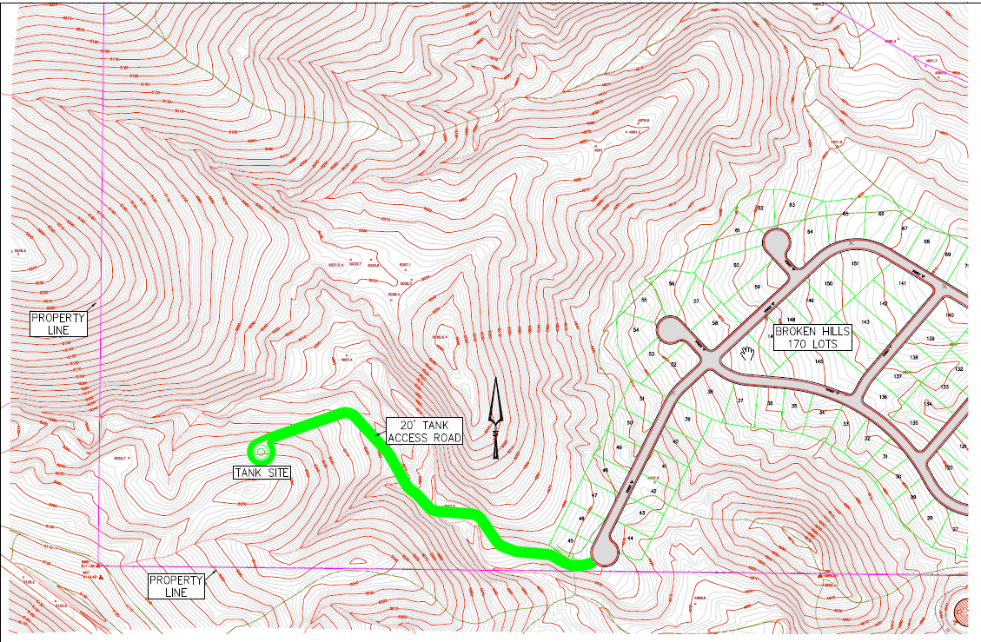
WSUP19-0015 Broken Hill Grading
Washoe County Board of Adjustment
October 3, 2019

Slide 2
Request
The application is requesting a special use permit (SUP) for major grading of an area of approximately 2.5 acres with 8,871 cubic yards of cut and 7,680 cubic yards of fill to construct an paved 1,600 foot long access road to a proposed 325,000 gallon water tank
The proposed grading is permitted with a special use permit per WCC 110.438. Therefore, the applicant is seeking approval of this SUP from the Board of Adjustment.

Slide 3
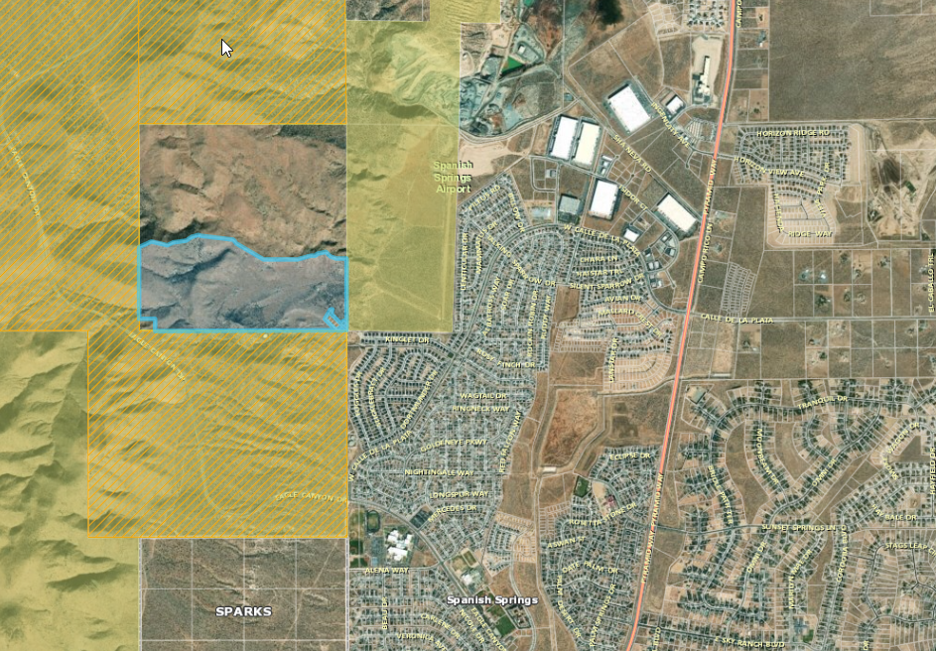
Project site

Slide 4
Background
The road is being graded to located a water tank at the terminus of the road for the planned Broken Hill development
2 acres will be graded for the road and ½ acre for the water tank site.
The material will be balanced on site and there will be no import or export of material
The road will be paved and dedicated in the future to TMWA or the HOA

Slide 5
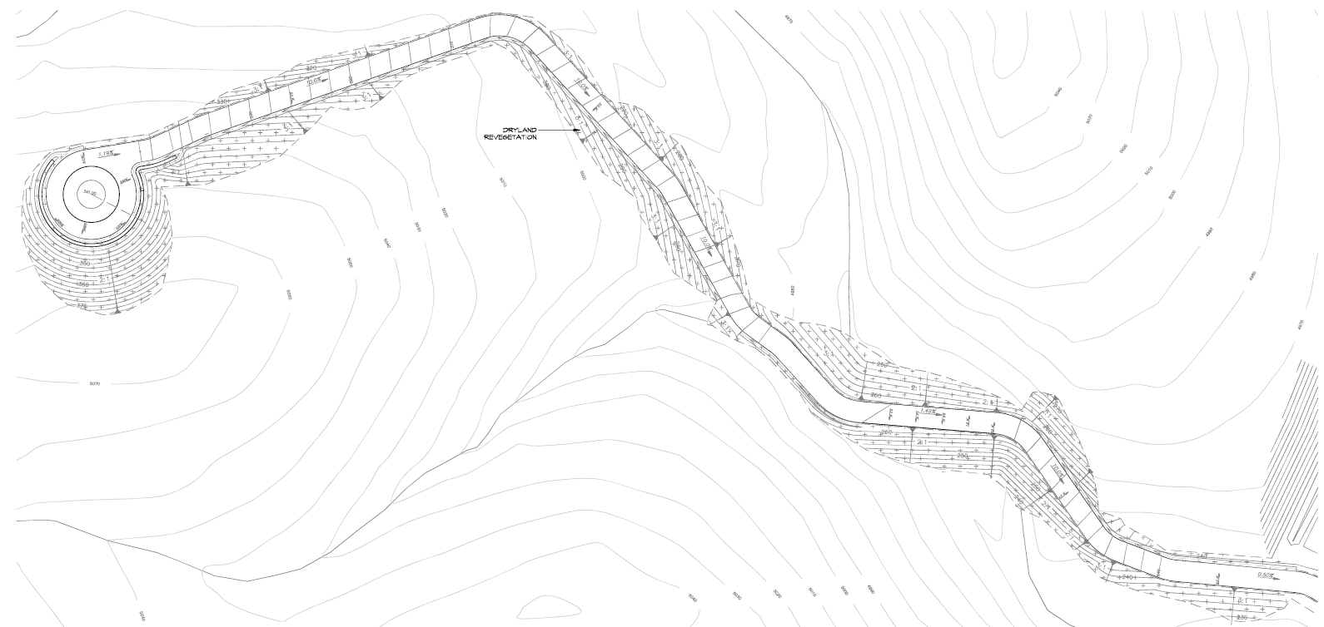

Slide 6
Analysis
There are areas where the slope is 2:1, which is allowed by code when the parcel is over 5 acres and the grading is more than 100 feet form the property line
A building permit will be submitted for the construction of the water tank

Slide 7
Public Notice & CAB
Public notice was sent to parcel within 1,000 feet from the site
The Spanish Springs CAB reviewed the application on September 4, 2019 and recommended to approve the project.

Slide 8
Reviewing Agencies
Various agencies reviewed the application, their comments are included in the staff report
Agencies with conditions, are included in the Conditions of Approval

Slide 9
Special Us Permit Findings
1. Consistency;
2. Improvements;
3. Site Suitability; and
4. Issuance Not Detrimental
Staff is able to make all the required findings, as detailed in the staff report

Slide 10
Possible Motion
I move that, after giving reasoned consideration to the information contained in the staff report and information received during the public hearing, the Washoe County Board of Adjustment approve with conditions Special Use Permit Case Number WSUP19-0015 for Barker-Coleman Investments, having made all the findings in accordance with Washoe County Code Section 110.810.30

